Slide 1
Legendary Grabbing Machine
Yao Zhao

Slide 2
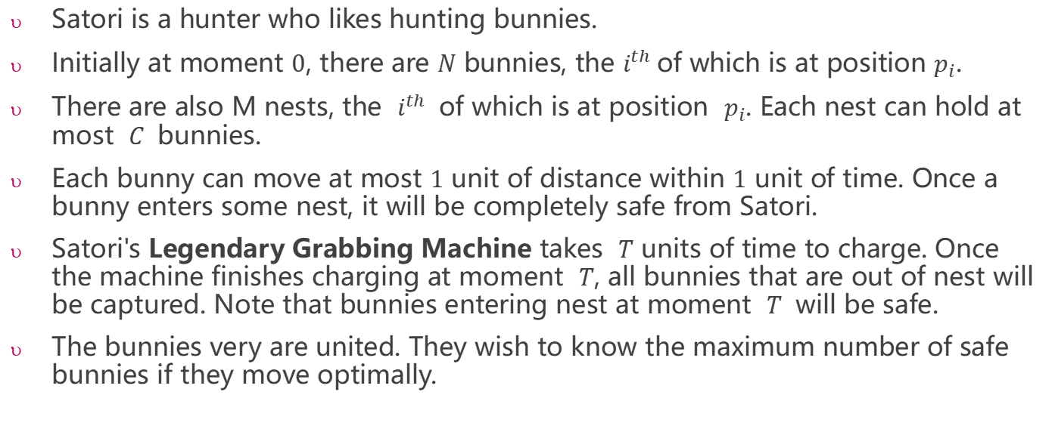
Legendary Grabbing Machine
Satori is a hunter who likes hunting bunnies.
Initially at moment $0$, there are $N$ bunnies, the $i^{th}$of which is at position $p_{i}$.
There are also M nests, the $i^{th}$ of which is at position $p_{i}$. Each nest can hold at most $C$ bunnies.
Each bunny can move at most $1$ unit of distance within $1$ unit of time. Once a bunny enters some nest, it will be completely safe from Satori.
Satori's Legendary Grabbing Machine takes $T$ units of time to charge. Once the machine finishes charging at moment $T$, all bunnies that are out of nest will be captured. Note that bunnies entering nest at moment $T$ will be safe.
The bunnies very are united. They wish to know the maximum number of safe bunnies if they move optimally.

Slide 3


Input:
2 2 1 5
45 55
40 60
Legendary Grabbing Machine
40
45
50
55
60
65

Slide 4
Input:
2 2 1 5
45 55
40 60
Output:
2
Legendary Grabbing Machine
40
45
50
55
60
65

Slide 5
Input:
2 2 1 5
55 65
40 60
Legendary Grabbing Machine
40
45
50
55
60
65

Slide 6
Input:
2 2 1 5
55 65
40 60
Output:
1
Legendary Grabbing Machine
Only hold 1 rabbit
40
45
50
55
60
65

